Slide 1
Recommender System
For Almost Anything
Product recommendation through Machine Learning

Slide 2
How this project originated?
Feedback from interviewers that they have massive data but too complex and no direction to start from.
Wants to have the insights but limited hands-holding
Answering The Key Question - "How are we going to tap on this immerse wealth of data and monetize it?“
Simulation using Netflix Prize data and MovieDB

Slide 3
01
02
Data
Concept
03
04
Afterthoughts
Demo
Tell me more about the data
The Modelling Journey
Conclusion, Limitations & Recommendations
Webapp demonstration

Slide 4
Problem Statements
To design and create a robust recommendation systems where titles are pushed to users based on their initial choices/preferences
Recommendation system must eliminate cold start problem for new users - New users should be provided with recommendations that are in-line with their preferences.

Slide 5
01
Data
Tell me more about the data

Slide 6
Netflix Prize Data
Data from 2006
Contains 17,770 titles
100M++ user ratings
Limited information – Year of release; rating and date of ratings.
API calls to MovieDB to extract more information – Keywords, Genre & Featured Actor/Actress.

Slide 7
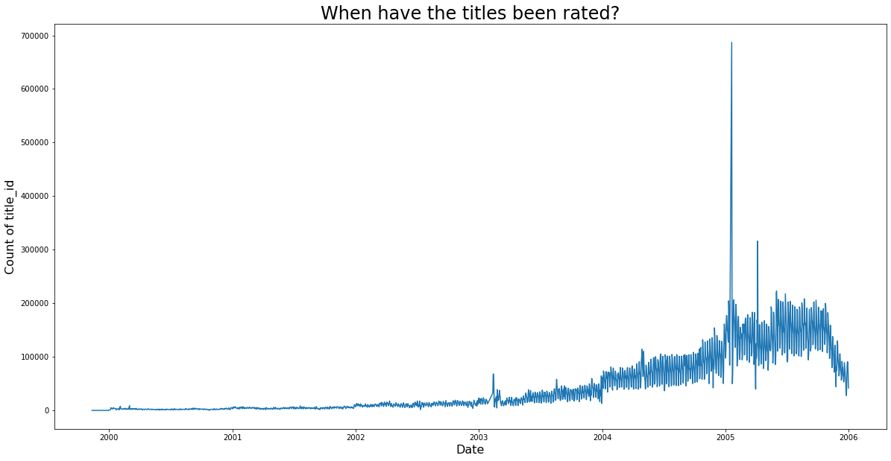
When have titles been rated
300%
USD$1M
Novelty
Surge in subscribers from 2.1M -> 6.3M in 2005
Lauch of Netflix Prize for recommender system
Dwindle in rating as it may become a hassle as novelty wane

Slide 8
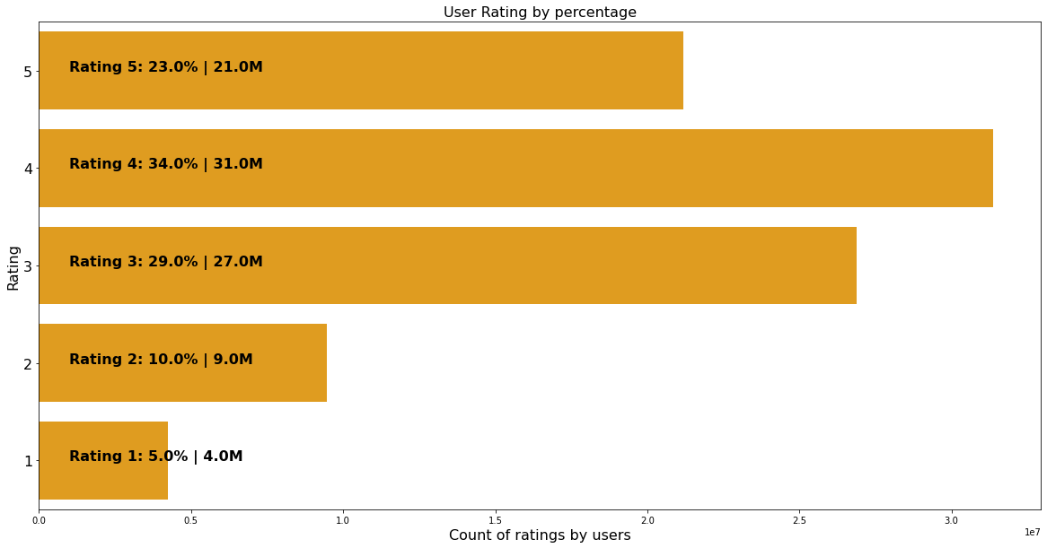
More Positive
User Rating Profile
Users tends to rate if they like the movies
Vigilante’s rating for bad movies

Slide 9
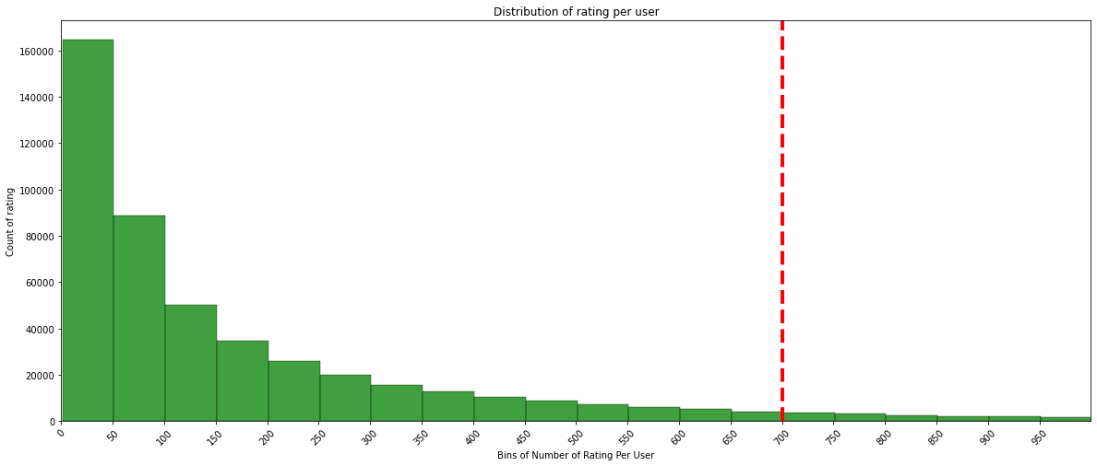
Less is good
User Rating Profile 2
Most users only rate about 50 titles.
Look for active rater >= 700 ratings

Slide 10
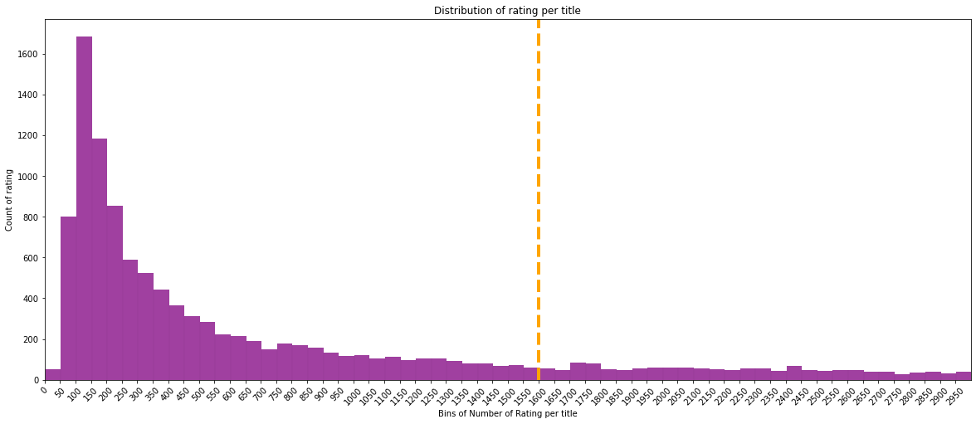
More is good
Titles Rating Profile
Most movies only have about 100-150 ratings.
Look for movies that have ratings >= 1600

Slide 11
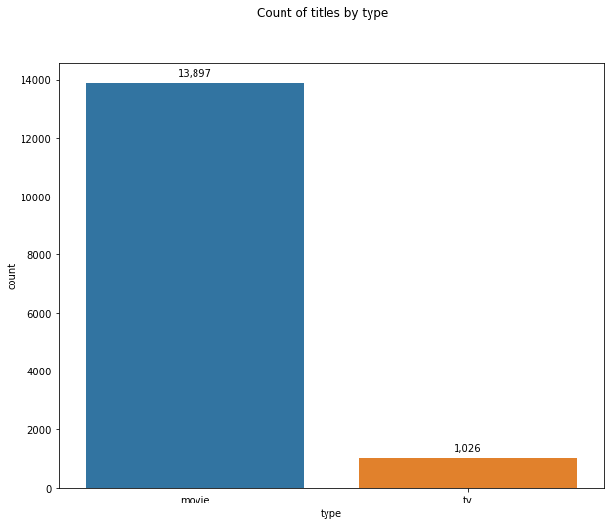
Titles Profile
13x more movies than tv mini-series

Slide 12
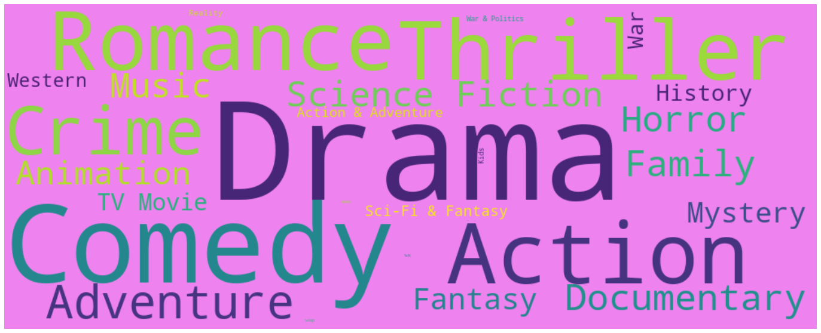
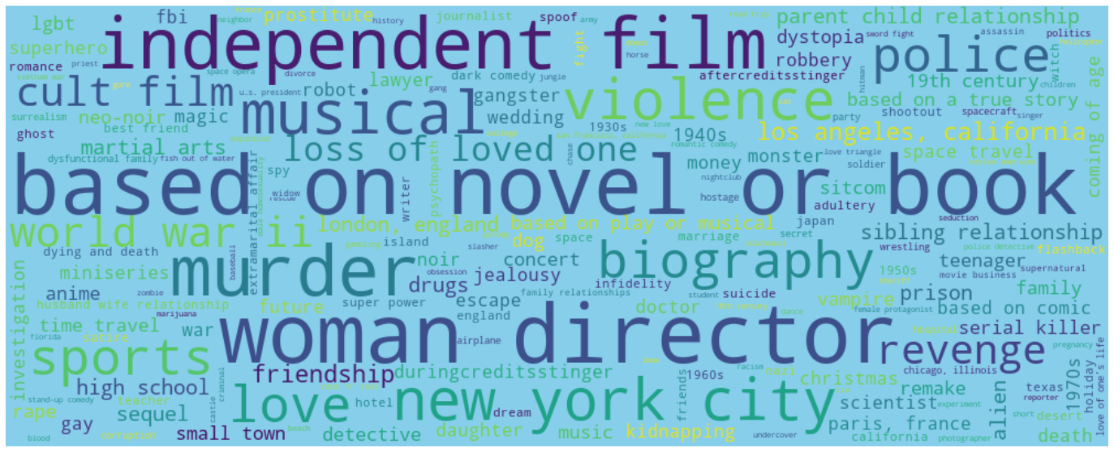
Titles Profile 2
28 Genre
12,226 Keywords

Slide 13

Modeling Journey
14,923 titles dropped to 5,198 titles
Data cleaning
Subsetting
Model Selection
Defining User
17,770 titles dropped to 14,923 titles
Collaborative Filtering
Title-based Filtering
Neural Network Sys
Ensemble (Top Scoring)

Slide 14

Collaborative Filtering
Next Closest User in DB
User-weighted Titles Ranking
Composite Socring
Eliminate Cold Start Problem for New Users
Find the weight of user’s cosine similarity against other users to rank all available titles in subset
Standardized Score and find the Top 5 movies based on closest user

Slide 15
Title Based Filtering
Ranking of Titles
Distance Calculation
Composite Scoring
User’s Rating of 5 random chosen titles will be converted to ‘weight’ multiplier
(user multiplier)
Rank titles against other titles based on cosine similarity and applied user multiplier
Standardized Score and find the Top 5 movies based on composite socre

Slide 16


Embedding
NN Weighting
Composite Scoring
Concept & Model heavily inspired by the following article: https://towardsdatascience.com/building-a-recommendation-system-using-neural-network-embeddings-1ef92e5c80c9
Keywords Filtering (NN Model)
Ranking of Titles
User’s Rating of 5 random chosen titles will be converted to ‘weight’ multiplier
(user multiplier)
Create numeric array of title & keywords using movie_ids & keyword_ids
Using Neural Network to calculate the embedding weighting in 50 epochs & applies user multiplier
Standardized Score and find the Top 5 movies based on composite socre

Slide 17
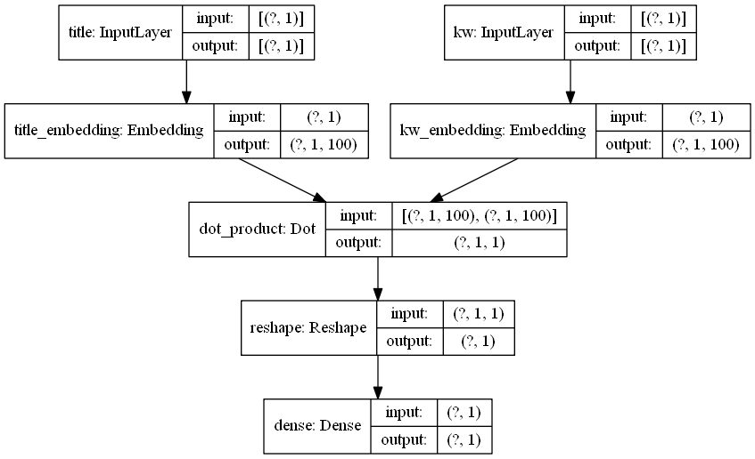
Creating 100 features

Slide 18
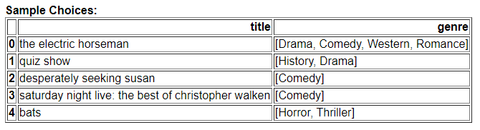
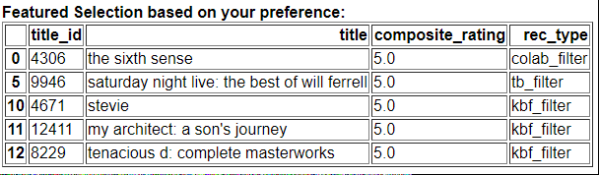
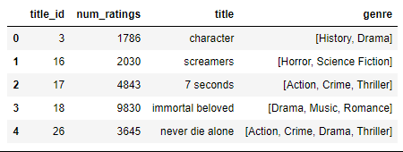
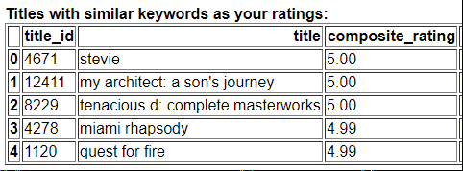
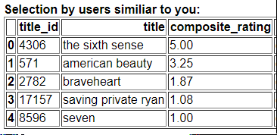
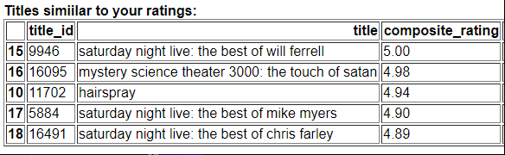
Recommendation Comparison
Input
Ensemble
Keywords Filter
Collaborative Filter
Title Filter
Legends:
Base Recommendation

Slide 19
C.L.M
Conclusion
Provide more user-inclined titles compared to popularity based recommendations
Ensemble model is more generalized compared to individual model – recommendations based on specific aspect of information
Limitations
Calculations bottleneck in traditional ML | Training bottleneck in Neural Network
Incomplete data in MovieDB
Recommendations
Word Vectors (TDIDF) of title-based recommendations
Exploring deeper into evaluation metrics for recommendation systems

Slide 20

An App Is Worth a Thousand Words

Slide 21
Thanks!
Do you have any questions?
https://www.linkedin.com/in/kevinseek/

